Slide 2
Artificial Intelligence Use Case: Self-Protecting Data
Joe DiGiovanni, Section Chief, Enterprise Services Security Engineering
HQ Cyberspace Capabilities Center
Scott Air Force Base, IL
DISCLAIMER: Any mention of any products, services, and/or companies is provided for exemplary purposes only and does not constitute an endorsement by Air Combat Command, the United States Air Force, or the Department of Defense.

Slide 3
Agenda
Concept Background
Research Summary
WashU Capstone
Univ of Alabama Huntsville
Next Steps

Slide 4
Motivation

Slide 5
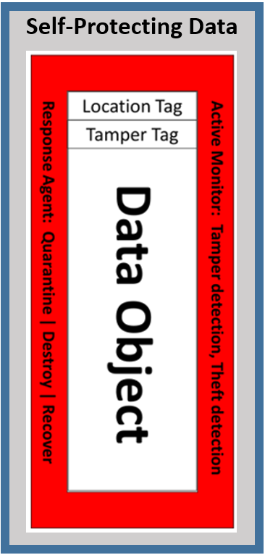
Background
It all began at AFCEA Cyber Symposium 2016
Problem: Current methods of data protection don’t always work, and have too many dependencies on the systems and networks involved in a data object’s lifecycle.
Idea: What if data objects could be wrapped with monitoring and response capabilities in addition to encryption…throughout the lifecycle…as independent of infrastructure as possible.
Key Concepts:
Tags for attributes such as Location, Sensitivity, Timeliness, and Tampering
Active Monitors for Theft and Tamper detection
Response Agent for Destruction, Recovery, Quarantine and Alerting

Slide 6
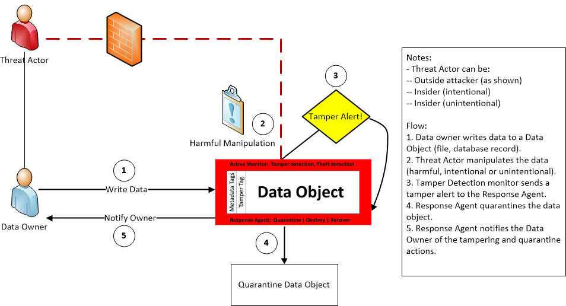
Background (continued)

Slide 7
Research
Graduate research at Washington University, Fall 2017
Hacking 4 Defense (H4D), University of Alabama Huntsville, Spring 2020
In partnership with HQ CCC Data Analytics, Research, and Innovation office for more research opportunities
H4D Round Two – Washington University

Slide 8
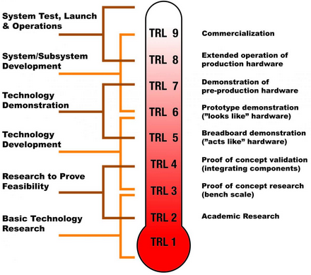
Washington University
Cryptographic Techniques
Blockchain
Self Protecting Object
Virtual DataSafe
Notes:
We’re going to talk about some of the different technologies that we explored as part of this project. A final solution could use all or some of these.
The DoD’s Technology Readiness Level evaluation method was used to identify the maturity level and next steps for each of these solutions. On this scale a 1 is where basic research and theoretical exploration occur, moving up to TRL 9 in which a technology is implementable. The concept of Self-Securing Data is at a TRL 1, which has made it difficult to identify any one technology or idea that can completely solve for the requirements given to us.

Slide 9
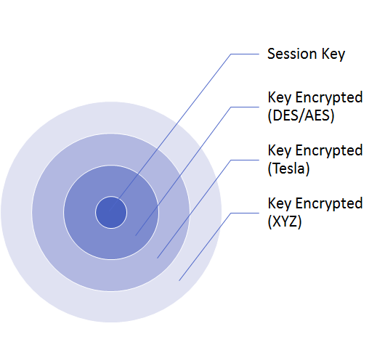
Cryptographic Techniques
Hash-based Message Authentication Code wrapping
Triple-Data Encryption Standard (DES) and Advanced Encryption Standard (AES)
Common encryption technique used today
Timed Efficient Stream Loss-tolerant Authentication (TESLA)
Sender/Receiver has synchronized clocks
Creates a chain of keys associated with time interval
A Layered Approach
Notes:
We will use HMAC wrapping to wrap the session key for decryption. You can rewrap it (like an onion) using different techniques. DES and AES are commonly used today. We also researched Time Efficient Stream Loss-tolerant Authentication (TESLA) which involves both the sender and receiver(s) to have synchronized clocks. This creates a chain of keys associated with time intervals

Slide 10
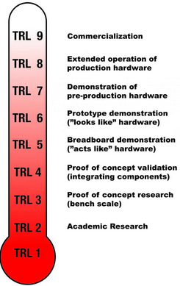
Cryptographic Techniques
Benefits
Mature Technology
Partially meets most requirements
Fairly easy to POC
Challenges
Delays in transmission (TESLA)
False Positives (Integrated Solution)
Direction
These technologies have been tested in isolation, the next step would be to do a Proof of Concept of an integrated solution
HMAC Wrapping
TRL 9/8
TESLA
TRL 5/6
Integrated Solution
TRL 3
Notes:
M’s Slide

Slide 11
Blockchain
Shared, distributed, tamper-resistant database
Requires paradigm shift in how we think about security
How it works:
Headers of blocks of data create a chain
Distributed Network
Trusted/untrusted actors
Full, partial, and simple nodes
Consensus methods
Access control
Confidentiality
Notes:
M’s Slide
Network monitoring, asset tracking, resilient communication
Headers of blocks of data create a chain
Hash of previous block
Timestamp
Hash of current block

Slide 12
Blockchain
Benefits
Immutable data at rest
Fault tolerant architecture
Assumes untrust
Challenges
Confidentiality relies on access controls
Newer technology, complex to POC
Agreement on Consensus Logic
Direction
Do a feasibility study focused on Blockchain
Focus on specific requirements for DoD/AF
Bitcoin
TRL 9
Military Application
TRL 2/3
Notes:
M’s Slide

Slide 13
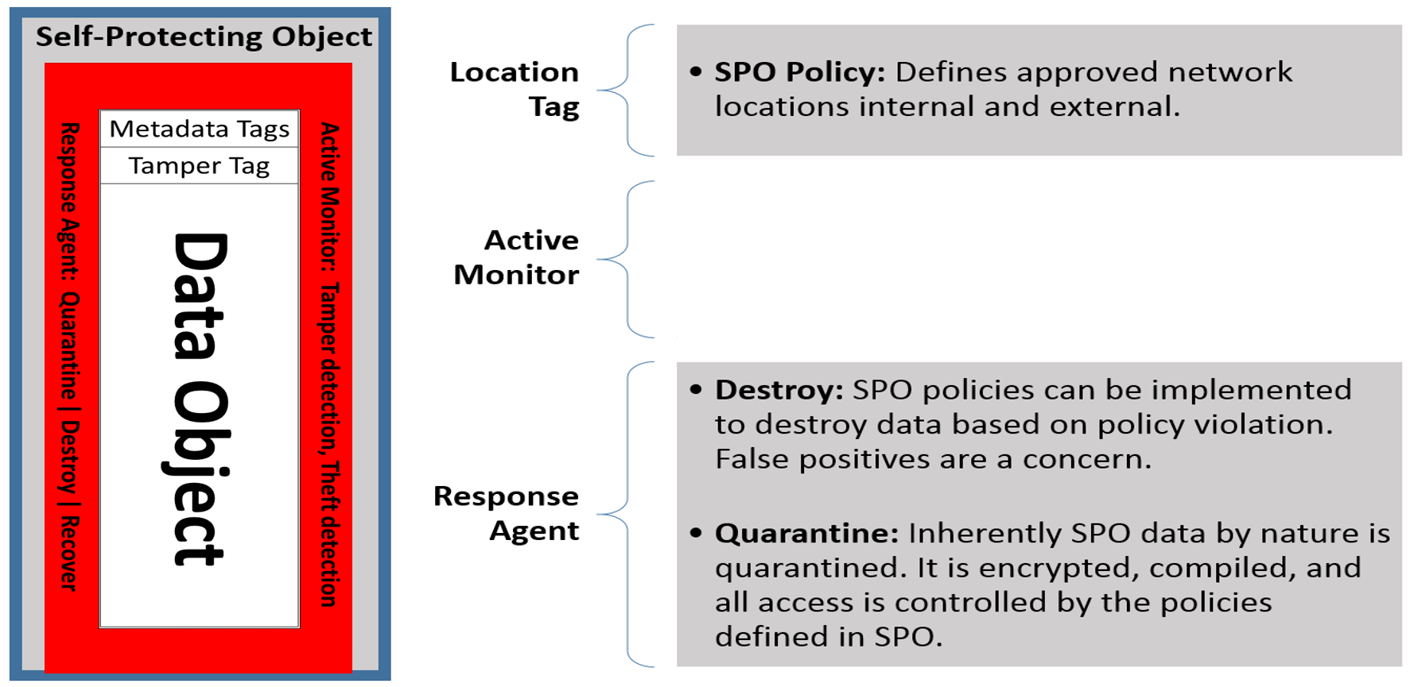
Self Protecting Object
Notes:
Dave:
The SelfProtect Object was designed by Dr. Shipping Chen from the University of Sydney looking at data writes management that is independent of a specific vendor.
Dr Chen implemented a proof of concept. Technologies used were Microsoft word, C# and XML Markup Control Language (XAMCL).
SPO Concept is to compile the document into a Dynamic Linked Library which provides a natural obfuscation through the use of public and private methods. The document is stored internally within the DLL.
SPO is embedded with XACML to define access/authorization controls.
To access the document they used Microsoft office tools to build a word plugin. The plugin allows the dll to execute the embedded protections when a user tries to view the document.
Controls implemented were a password and max number of views. After it reached its maximum views they could no longer open the document.
Gary:
XACML provides a methodology for defining attribute based policy access that is tailor able. For instance SPO object can contain XACML attributes that define Data Destruction, Location Based, Data view Limits, and IP.
SPO does not perform real-time tamper detection which requires active listening. However, upon an access request, the object is now active and can be coded to perform a variety operation including tamper to threat detection.
If desired the object could even destroy the data. False positives could lead to the risk of data lose.
The SPO data is inherently quarantined by nature, it is a compiled DLL that stores protected by imbedded access policies.

Slide 14
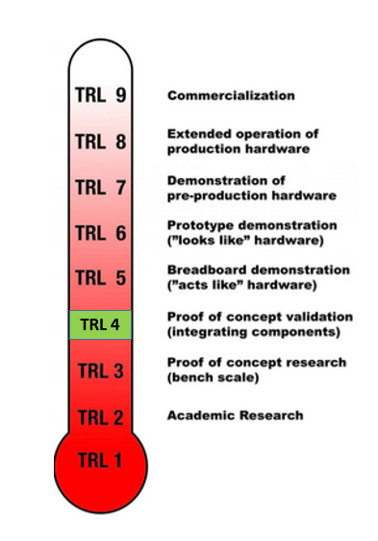
Self Protecting Object
Benefits
Mature Individual Technologies
Partially Meets Requirements
Challenges
Security issues with executable object
Increased payload size
False Positives
Notes:
Gary:
The individual technologies used to implement SPO are commercially mature. The SPO concept is on the TRL scale is at level 4.
It does not meet the active monitoring requirement because it needs to be running to work.
In addition it fails to meet the requirement for protecting of data created from this data includes the same controls.
Dave:
There are challenges for implementing, for example you are passing around an executable object and virus scan software is not a fan of that, exceptions required.
Potential increases to payload sizes.
False positives could potentially lead to SPO quarantining or destroying data.

Slide 15
A Virtualized DataSafe Concept
DataSafe uses custom computer hardware and software to protect data while in use, at rest, and in transit
Dr. Ruby B. Lee is a Professor at Princeton University who holds a patent on DataSafe
The Virtualized DataSafe concept is a purely software implementation of Dr. Lee's DataSafe that we created for this research
Monitors data - Tracks sensitive data by monitoring all operations against it while in use
Encrypts data – Encrypts data in use, at rest, and in transit
Isolates data - Requires all work on sensitive data to occur within a secure environment
Enforces access policies
Notes:
I’s slide
We have direct acknowledgement from Dr. Lee that Virtualized DataSafe is feasible for some purpose

Slide 16
A Virtualized DataSafe Concept
Benefits
Highest level of security
Data is protected while in use, in transit, and at rest
Protection from hardware-level attacks
Portable
Challenges
Immature technology – TRL Level 2
Complex
Newer hardware recommended to support all security features

Slide 17
Washington University Recommendations
Crypto
Develop POC
Blockchain
Future Capstone project
Going to require more research to make educated decisions on applicability
Self Protecting Object
Integrate technology components in pilot environment
Expand the scope to include other Microsoft products and transactional based technologies
Virtualized DataSafe
Develop a working prototype
Partner with a VM software company to produce a product
Notes:
Team slide (how do we break out?)
DAVE/GARY SPO:
Adding additional components and integration with additional software will move this project to a TRL 5.
Our recommendation is to add the additional controls listed below for authorization and authentication to the self-protecting object implemented in a new pilot.
Destroy data
Location Based
Data view Limits
IP

Slide 18
University of Alabama – Huntsville
Hacking 4 Defense: Problem Description - Self Protecting Data
“The Air Force Chief Data Office needs a better way to monitor and protect data shared with partners outside of the military in order to ensure adequate data security throughout the data objects’ life cycle.”
Original Solution: Software wrapping of the data in order to provide portable security.
Semester Total Interviews: 27
Approximately 80 emails sent
Over 12 hours spent in beneficiary interviews
Project Research by
Team Arbiter
Notes:
We’re going to talk about some of the different technologies that we explored as part of this project. A final solution could use all or some of these.
The DoD’s Technology Readiness Level evaluation method was used to identify the maturity level and next steps for each of these solutions. On this scale a 1 is where basic research and theoretical exploration occur, moving up to TRL 9 in which a technology is implementable. The concept of Self-Securing Data is at a TRL 1, which has made it difficult to identify any one technology or idea that can completely solve for the requirements given to us.

Slide 19
Project Scope
Narrow the scope because of time
The AI possibilities had not yet been researchede Learning,
“...Most notably the use of AI techniques as part of a solution” - Mr. DiGiovanni
Focus on text files only to further reduce scope of the problem to a more manageable level
Notes:
We’re going to talk about some of the different technologies that we explored as part of this project. A final solution could use all or some of these.
The DoD’s Technology Readiness Level evaluation method was used to identify the maturity level and next steps for each of these solutions. On this scale a 1 is where basic research and theoretical exploration occur, moving up to TRL 9 in which a technology is implementable. The concept of Self-Securing Data is at a TRL 1, which has made it difficult to identify any one technology or idea that can completely solve for the requirements given to us.

Slide 20
Starting Plan
Notes:
We’re going to talk about some of the different technologies that we explored as part of this project. A final solution could use all or some of these.
The DoD’s Technology Readiness Level evaluation method was used to identify the maturity level and next steps for each of these solutions. On this scale a 1 is where basic research and theoretical exploration occur, moving up to TRL 9 in which a technology is implementable. The concept of Self-Securing Data is at a TRL 1, which has made it difficult to identify any one technology or idea that can completely solve for the requirements given to us.

Slide 21
Final Plan
Notes:
We’re going to talk about some of the different technologies that we explored as part of this project. A final solution could use all or some of these.
The DoD’s Technology Readiness Level evaluation method was used to identify the maturity level and next steps for each of these solutions. On this scale a 1 is where basic research and theoretical exploration occur, moving up to TRL 9 in which a technology is implementable. The concept of Self-Securing Data is at a TRL 1, which has made it difficult to identify any one technology or idea that can completely solve for the requirements given to us.

Slide 22
“Arbiter” Scope
semi-supervised
Notes:
We’re going to talk about some of the different technologies that we explored as part of this project. A final solution could use all or some of these.
The DoD’s Technology Readiness Level evaluation method was used to identify the maturity level and next steps for each of these solutions. On this scale a 1 is where basic research and theoretical exploration occur, moving up to TRL 9 in which a technology is implementable. The concept of Self-Securing Data is at a TRL 1, which has made it difficult to identify any one technology or idea that can completely solve for the requirements given to us.

Slide 23
Purpose of AI in Self-Protecting Data
SPD Objective:
Wrap data objects with monitoring and response capabilities in addition to encryption…throughout the lifecycle…as independent of infrastructure as possible
AI Objectives:
Adaptive monitoring of anomalous behavior
Dynamic adjustment of data protection profile
Metadata may not always be static
Confidentiality, Integrity, Availability priorities may change over time
Adaptive response actions (quarantine, destroy, recover)
AI integration in payload for maximum portability

Slide 24
Solution Illustration
Notes:
We’re going to talk about some of the different technologies that we explored as part of this project. A final solution could use all or some of these.
The DoD’s Technology Readiness Level evaluation method was used to identify the maturity level and next steps for each of these solutions. On this scale a 1 is where basic research and theoretical exploration occur, moving up to TRL 9 in which a technology is implementable. The concept of Self-Securing Data is at a TRL 1, which has made it difficult to identify any one technology or idea that can completely solve for the requirements given to us.

Slide 25
Use Case – Excessive Data Copy
Notes:
We’re going to talk about some of the different technologies that we explored as part of this project. A final solution could use all or some of these.
The DoD’s Technology Readiness Level evaluation method was used to identify the maturity level and next steps for each of these solutions. On this scale a 1 is where basic research and theoretical exploration occur, moving up to TRL 9 in which a technology is implementable. The concept of Self-Securing Data is at a TRL 1, which has made it difficult to identify any one technology or idea that can completely solve for the requirements given to us.

Slide 26
Use Case – Suspect Behavior, Disconnected Ops
Notes:
We’re going to talk about some of the different technologies that we explored as part of this project. A final solution could use all or some of these.
The DoD’s Technology Readiness Level evaluation method was used to identify the maturity level and next steps for each of these solutions. On this scale a 1 is where basic research and theoretical exploration occur, moving up to TRL 9 in which a technology is implementable. The concept of Self-Securing Data is at a TRL 1, which has made it difficult to identify any one technology or idea that can completely solve for the requirements given to us.

Slide 27
Use Case – Exceeding Access Time
Notes:
We’re going to talk about some of the different technologies that we explored as part of this project. A final solution could use all or some of these.
The DoD’s Technology Readiness Level evaluation method was used to identify the maturity level and next steps for each of these solutions. On this scale a 1 is where basic research and theoretical exploration occur, moving up to TRL 9 in which a technology is implementable. The concept of Self-Securing Data is at a TRL 1, which has made it difficult to identify any one technology or idea that can completely solve for the requirements given to us.

Slide 28
UAH Conclusion
Getting to the Next Level
Structure allows for data owners to choose security attributes
Build training data based on attributes
Attributes of Machine Learning Algorithm
Needs to be both supervised and unsupervised – likely semi-supervised
Will need to have implementations of ML
Classification
Regression
Probability Estimation
Others?
Notes:
We’re going to talk about some of the different technologies that we explored as part of this project. A final solution could use all or some of these.
The DoD’s Technology Readiness Level evaluation method was used to identify the maturity level and next steps for each of these solutions. On this scale a 1 is where basic research and theoretical exploration occur, moving up to TRL 9 in which a technology is implementable. The concept of Self-Securing Data is at a TRL 1, which has made it difficult to identify any one technology or idea that can completely solve for the requirements given to us.

Slide 29
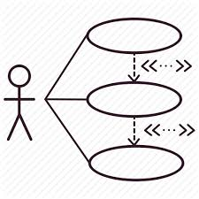
“Day Job” Use Cases
Cross Domain Data Transfer
Self-protecting data objects could take on much of the logic currently in today’s guards
This gets us closer to a multi-level secure enterprise
Cross Domain Approval Process
More than just process automation
Complex decision engine

Slide 30
What’s Next?
Proof of Concept: Use of Artificial Intelligence methods
Machine learning, Deep learning
Chief Data Office support – More Use Cases
Investigate other possible technologies – quantum computing, …

Slide 31
Questions

