Slide 1
360°Threat Elimination: Natively
Pico Segmentation and
Application Security
By
Amitabh Sinha
Michael Hodge
HQ: 2150 Trade Zone Blvd., San Jose CA 95131
Notes:
Good afternoon and thank you all for coming today
Richard, thank you for the gracious introduction.
So let me start with a question
How many of you received an email recently that read something like this:
Dear Mr. Smith, we regrettably have to inform you that your personal data MAY have been exposed due to a VERY SMALL breach in our data center
But “don’t worry, we have it all under control and you are OK”….
As a precaution however, we recommend you change your PASSWORDS, CREDIT CARDS, PASSPORTS and contact the FBI….
I’m with Avocado Systems and I’m here today to speak with you about our new, patented approach to application and data security

Slide 2
Data Breaches have grown in size and sophistication
885M
500M
140M
50M
106M
110M
79M
2015
2016
2017
2018
2019
2020
Notes:
SOOOOO, Raise your hands if you have ever received THAT letter I mentioned from one of these companies?
So you would think someone would solve this problem but as recent as a few weeks ago, Citrix announced the Iranians have been inside its data center for 10 years,
AND what do all of these incidents have in common?
They all had the best perimeter defenses money could buy and yet, they were still breached by threats that went undetected for months and years.

Slide 3
The US Gov and DoD are not immune
May-July 2019 DISA Data Breach
PII for 200,000 persons exposed
2017 US Army INSCOM and NSA
2017: 100GB of data about DCGS-A exposed
2015 IRS Data Breach:
700,000 tax-payer records exposed
July 2015 OPM: First attack: hackers penetrated the Office of Personnel
Management’s personnel database and stolen records for about 4.2 million people.
Second attack: affected more than 19 million people who applied for clearances
November 2008: the Army caught a worm called Agent.btz crawling through
the Defense Department’s SIPRNET. It took 14 months to eradicate.
2008
2015
2015
2017
2019
Notes:
SOOOOO, Raise your hands if you have ever received THAT letter I mentioned from one of these companies?
So you would think someone would solve this problem but as recent as a few weeks ago, Citrix announced the Iranians have been inside its data center for 10 years,
AND what do all of these incidents have in common?
They all had the best perimeter defenses money could buy and yet, they were still breached by threats that went undetected for months and years.

Slide 4
A New Approach is Needed
Notes:
So how about a new approach beyond perimeter defenses?
What if we move security to the applications themselves?
What if applications were self-protecting and could fight back?
That is what Avocado Security Platform does.

Slide 5
Any CLOUD
Any OS
Any APP
Notes:
Additionally,
With Avocado you have a single solution for your application, web and data tiers
AND Avocado works with any Operating System, Architecture or Application, even legacy applications.

Slide 6
Avocado successfully completed a year-long USAF evaluation of its solution
Multiple follow-on initiatives under AFLCMC/PEO-Digital
AF Weather Service: Pilot evaluating cloud migration and protection against multiple non-DoD Information and data sources
BCS-F: Protecting USAF and FAA integrated radar networks associated with ADIZ management
Zero Trust for a classified program
Protection of 5G networks at the MEC
Notes:
So now you have to make a decision,

Slide 7
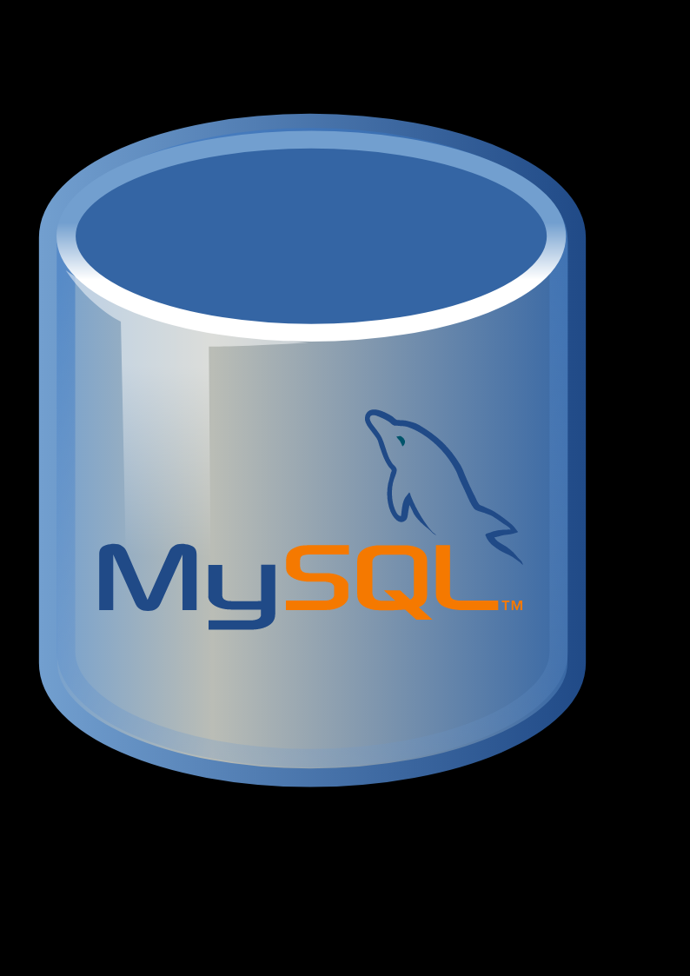
Why Breaches Continue to happen?
1. Perimeter Protection Deficient
Stolen credentials
Polymorphism
Zero-day vulnerabilities
2. Feeble Internal Threat Detection
Easy migration of threat
Unchecked Data exfiltration
Notes:
Why is this occurring?
Threats penetrate the perimeter , find vulnerable applications, then migrates from application to application across your data center. Installing BOTS, collecting data and damaging operations

Slide 8
Threat migration and proliferation
Application # 1 Oracle DB
Application # 2 Apache
Process 0 | Process 1
Process 2 | Process 3
Process A | Process B
Process C | Process D
Application
Notes:
Once in the bad agent moves from process to process.
Re-writing scripts and stealing or what’s called “exfiltrating” data.
And as we noted earlier, typically inside for an extended period.

Slide 9
What is needed?
Perimeter :
Granular perimeter definition
Instant breach detection
Inside the Perimeter :
Micro level threat detection and mitigation.
Eliminate lateral migration
Proactive data exfiltration detection.
Notes:
So what is required:
For the Perimeter…..
But bad guys can still find a way to get in.
“Inside” is where Avocado has focused. To develop the tools to ……

Slide 10
Wrap each Application in its own Coat of Security
Perimeter Protection
Next -Gen Firewalls
IDS
IPS
Runtime App Protection
Legacy Apps
Notes:
Avocado provides applications with the ability to defend themselves by introducing security to each application individually with functions such as IDS, IPS and advanced firewalls
Applications are now able to fight back
Additionally, security is now travels with your applications from cloud to cloud
But let’s be honest, this is really not enough is it?
After all, these are just versions of the same perimeter defenses that have already proven to be porous.
So Avocado goes one step further

Slide 11
Pico-Segmentation
Enables
Zero Trust Architecture
No Policies
No Threat Libraries
Zero Day Attacks
Near Zero False Positives
Legacy Apps
Notes:
So let’s add a little magic and call it Pico-segmentation
Now there is no way I can explain Pico-segmentation in the few minutes I have today but trust me, it is a little magic and a lot of math
With Pico segmentation we protect your applications at the process level
Think of these as highways between applications that allow applications to work with each other
We do this without the need for policies or threat libraries or other disruptive measures
AND you the user end up with a solution that provides comprehensive protection and detects zero day attacks while generating no false positives among many other capabilities

Slide 12
Spectrum of Deep Application Attributes
Company / Organization
Business Unit
Virtual Rack
Unique to Avocado
Server / VM / Host
Container
Exec. Platform
Apps
Process ID
Socket
Descriptors
Platform Name
Path
Fingerprints
Application Name
Path
Fingerprints
Descriptor
Protocol
Ports
Payloads
Unique IDs
Segments
Sessions
Threats
Network Perimeter Security
Infrastructure Security
Application Security
Confidential & Copyright © 2020 Avocado Systems Inc. All rights reserved.
10/31/2020
12

Slide 13
Avocado Security Platform : Self-Defending Applications
Security
Pico-Segmentation
Application
Compliance
Deep application and threat visibility
Mitigate, Forensics, Events and Reports
Seamlessly embeds Security, Pico-Segmentation and compliance into applications.
Notes:
Watch video here after this slide.
Avocado Cloud Security Platform : Solution (Please watch the video)
https://www.youtube.com/watch?v=c1K-Mv2UzRQ

Slide 14
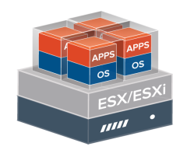
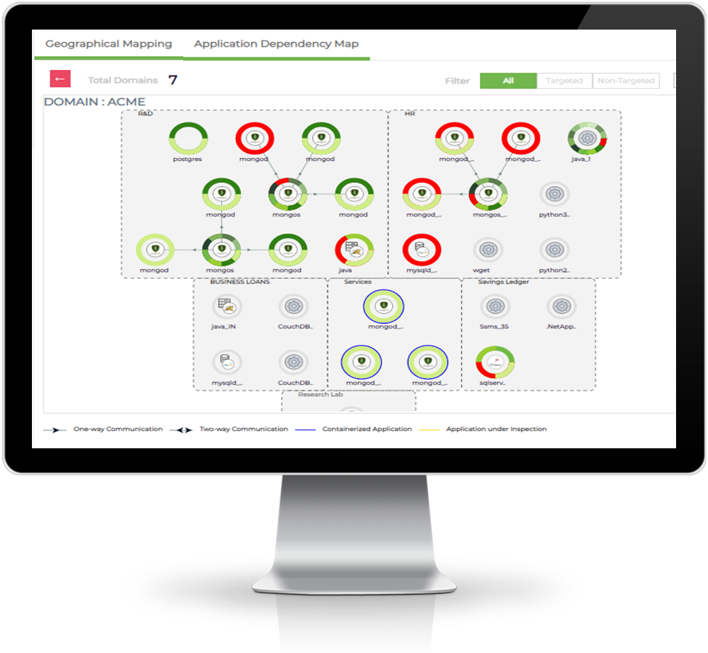
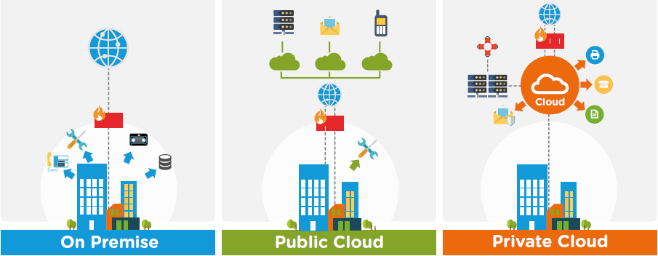
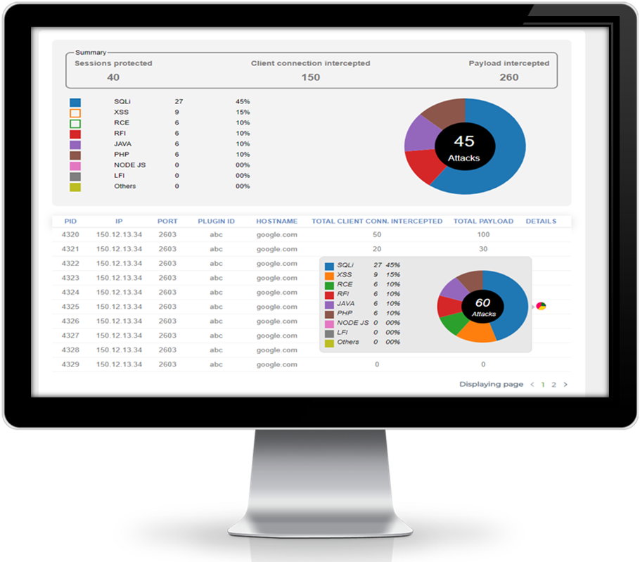
How is it operationalized?
Avocado Security Plugin
App centric security
Pico-segmentation
Compliance monitor, enforcement.
Statistics collection.
CI/CD
Micro-services,
server-less, APIs
SQL, NoSQL,
Time Series, IMDB databases
Bare-Metal Apps
Virtualized Apps
Containerized Apps
Avocado
Reveal
Avocado Security Orchestrator
Finest App Control
Application discovery, Deep visibility
Pico Segment and configuration management
SoC Interface
Avocado
Protect
Avocado
Integrate
Avocado Security
Orchestrator
Confidential & Copyright © 2020 Avocado Systems Inc. All rights reserved.
10/31/2020
14
Notes:
Avocado Security Platform comprises of The Orchestrator and Plugins
Avocado Reveal for discovery and analysis
Avocado Protect for application segmentation, compliance and security
Avocado Integrate for Top SOC, SEIM, Service Mgmt & Third Party integrations

Slide 15
3 Tier Application Security Under Single Control
Dynamic Zero Trust Controls between application tiers
Web Tier
App Tier
DB Tier
Web-Tier
Applications in App-Tier
Applications in DB-Tier
Avocado Security Platform
Notes:
Whether you are running applications on web tier or app tier, avocado can protect them deterministically for you.

Slide 16
©2020 Avocado Systems Inc.
10/31/2020
Avocado’s Patented Application Security Platform combines:
App-Native | Zero-Trust+ | Pico-Segmentation | Runtime Protection |AI/ML Neuron Functions
deep within applications at any scale
Avocado Reveal
DevSecOps
Avocado Protect
Zero Trust Architecture
Application Threat Dependency, Visibility and Deep Attributes
Sanctioning & Fingerprinting of deep application attributes, communications & payloads
Automated software defined controls compliance of legacy and current generation applications
Automated Threat Modeling with industry leading threat engines
Patented, Pico Segmentation based, Zero Trust Protection at Runtime
Industry and IT Compliance controls enforced for PCI DSS, PII, HIPAA, NIST 800-207, NIST 800-53 etc.
Patented self-learning Neuron Function based threat detection and protection
Analytics & visualization through API integration into SIEM/SOAR and in-built reporting & dashboards
At-Breach and Post-breach application forensics
Onboarding & Contextualization of Deep App Attributes & Forensics
App Sanctioning and Auto Segmentation with Runtime Zero-Trust Protection
Continuous & Automated Compliance Monitoring & Control Enforcement
Inspection
& Visibility
Onboarding
& Protection
Compliance &
Analytics
1.
2.
3.
16

Slide 17
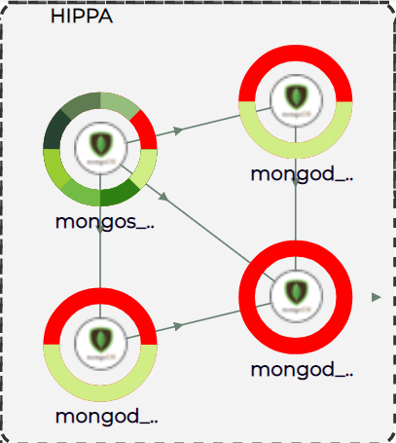
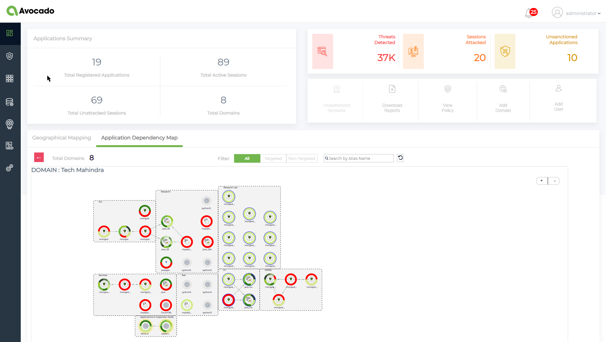
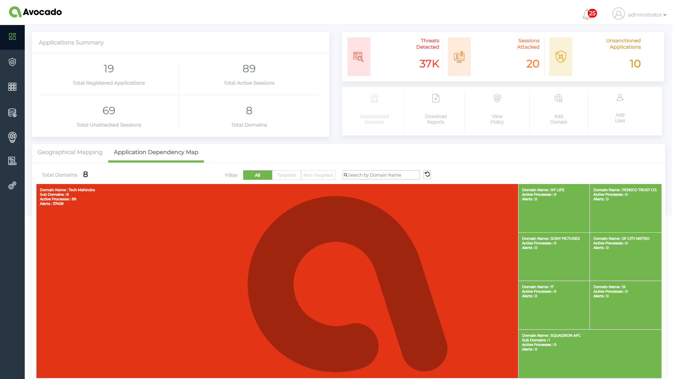
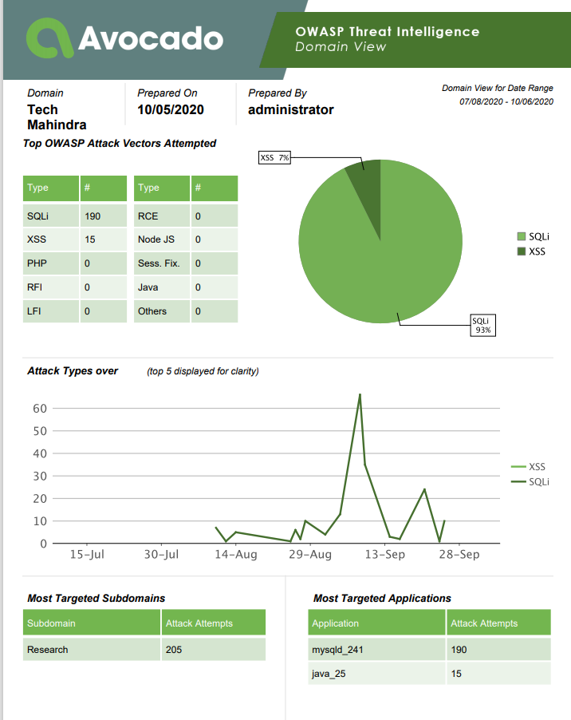
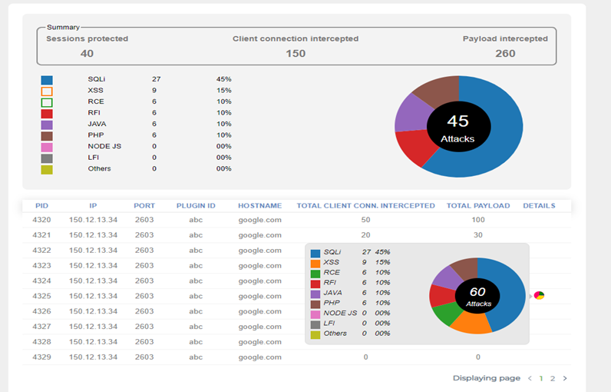
Avocado Security Platform Providing Deep Visibility & Protection
Reveal
Protect

Slide 18
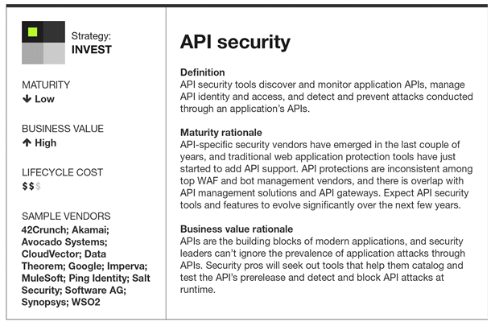
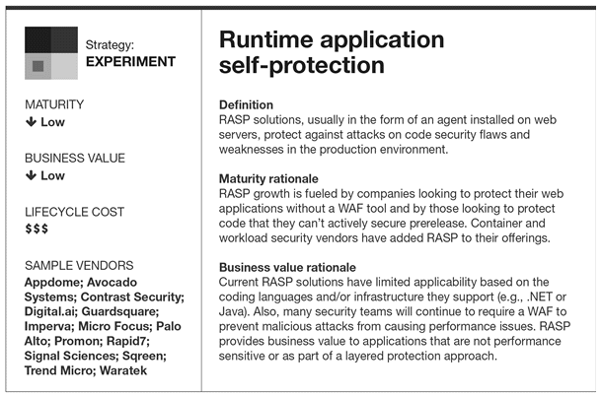
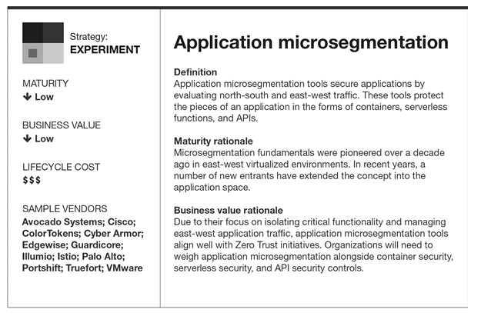
Avocado Recognized in 3 Key Technologies

Slide 19
Reduction in Cost and Improvement in Performance
Perimeter Security
20 %
Load Balancer
App Load Balancer
Load Balancer
Monitoring
Monitoring
Monitoring
WAF
App FW
App FW
Web Tier
App Tier
DB Tier
Behavioral
Analytics
Work Load
W-WL0
Work Load
W-WL1
Work Load
A-WL0
Work Load
A-WL1
Work Load
D-WL0
Work Load
D-WL1
Network Mirroring
Threat Monitoring
Work Load
W-WL2
Work Load
W-WLn
Work Load
A-WL2
Work Load
A-WLn
Work Load
D-WL2
Work Load
D-WLn
Avocado Systems Inc.
10/30/2020
19
Notes:
At any given time in a data center or in the cloud, 20% traffic is coming in and 80% traffic is being generated within the data center or in the cloud. To protect or securely segment 80% of traffic between the Web, App and DB tiers, customers often use traditional segmentation solutions (VMware NSX) combined with Next Gen Firewall with IDS and IPS solutions.
All these virtual or physical appliance based solutions are not only expensive but create a traffic bottleneck because all traffic must go via these appliances. As a result, the overall application performance gets impacted.

Slide 20
Reduction in Cost and Improvement in Performance
Perimeter Security
Key Benefits: Distributed Security functions for scaled-out applications
Reduce the East-West security appliances costs by 70%.
Eliminate performance bottle necks caused by East-West security appliances.
Achieve better security with less resources i.e. negligible policy configuration.
80 %
Load Balancer
App Load Balancer
Load Balancer
Monitoring
Monitoring
Monitoring
WAF
App FW
App FW
Web Tier
App Tier
DB Tier
Behavioral
Analytics
Work Load
W-WL0
Work Load
A-WL0
Work Load
D-WL0
Work Load
W-WL0
Work Load
W-WL1
Work Load
A-WL0
Work Load
D-WL0
Work Load
W-WL1
Work Load
A-WL1
Work Load
D-WL1
Work Load
A-WL1
Work Load
D-WL1
Network Mirroring
Threat Monitoring
Work Load
W-WL2
Work Load
W-WLn
Work Load
W-WL2
Work Load
W-WLn
Work Load
A-WL2
Work Load
A-WLn
Work Load
D-WLn
Work Load
A-WL2
Work Load
A-WLn
Work Load
D-WL2
Work Load
D-WLn
Work Load
D-WL2
Avocado Systems Inc.
10/30/2020
20
Notes:
Avocado can eliminate the traffic bottlenecks by provide Firewall, IPS and IDS security functions sitting next to the applications. As a result the application security becomes scale-out, reducing the cost by 70% and improving the overall application performances by 20%.

Slide 21
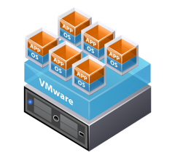
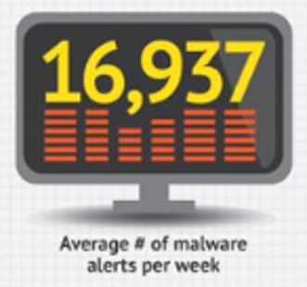
Avocado Security Platform: Incremental Benefits
Single Solution for Security, Segmentation and Compliance
Perimeter Security
Load Balancer
Load Balancer
Load Balancer
Monitoring
Monitoring
Monitoring
WAF
App FW
App FW
Bare-Metal
Virtualized
Containerized
Micro-services, serverless Lambda Functions, APIs
Web Tier
App Tier
DB Tier
Single solution across all the platforms, reduces the presence of point solutions by 1 FTE*.
Reduces number of IT resources (easy setup/configuration, minimum policies) by 2 FTE.
Work Load
W-WL0
Work Load
A-WL0
Work Load
D-WL0
Work Load
W-WL0
Work Load
W-WL1
Work Load
A-WL0
Work Load
D-WL0
Work Load
W-WL1
Work Load
A-WL1
Work Load
D-WL1
Work Load
A-WL1
Work Load
D-WL1
Work Load
W-WL2
Work Load
W-WLn
Reduction in false positives and negatives reduces need for SOC engineers by 3 FTE.
Work Load
W-WL2
Work Load
W-WLn
Work Load
A-WL2
Work Load
A-WLn
Work Load
D-WLn
Work Load
A-WL2
Work Load
A-WLn
Work Load
D-WL2
Work Load
D-WLn
Work Load
D-WL2
©Avocado Systems Inc. | Confidential |
Eliminates the need for East-West security appliances costs by 70%.
25% Increase in performance enhancement by reducing bottlenecks.
*FTE=Full Time Equivalent

Slide 22
Thank You
Amitabh Sinha asinha@avocadosys.com
Michael Hodge mhodge@avocadosys.com
Notes:
Good afternoon and thank you all for coming today
Richard, thank you for the gracious introduction.
So let me start with a question
How many of you received an email recently that read something like this:
Dear Mr. Smith, we regrettably have to inform you that your personal data MAY have been exposed due to a VERY SMALL breach in our data center
But “don’t worry, we have it all under control and you are OK”….
As a precaution however, we recommend you change your PASSWORDS, CREDIT CARDS, PASSPORTS and contact the FBI….
I’m with Avocado Systems and I’m here today to speak with you about our new, patented approach to application and data security

