Slide 2
Current Trends in Portfolio Valuation
Sumeet Bhatnagar, ABV
Managing Director, KPMG
Antonella Puca, CPA/ABV, CFA
Partner, BlueVal

Slide 3

Sumeet Bhatnagar, ABV
Sumeet Bhatnagar is a Managing Director in KPMG’s Economic & Valuation Services practice in New York where he is responsible for the analysis and valuation of a variety of financial instruments for clients in the financial services industry. Sumeet has over 18 years of financial valuation experience and has rendered numerous valuations of debt and equity instruments for financial and SEC reporting, corporate tax planning, mergers and acquisitions, litigation support, and restructuring and bankruptcy.
Prior to joining KPMG, Sumeet worked for Grant Thornton where he was a Senior Manager in the New York Valuation Practice. He was also a Manager in the San Francisco Valuation Practice of Huron Consulting Group prior to its acquisition by Grant Thornton and an investment banking analyst at Edgeview Partners where he provided financial advisory services. Sumeet is a member of the AICPA and serves on the AICPA Business Valuations Committee.

Slide 4
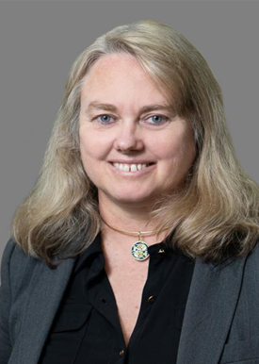
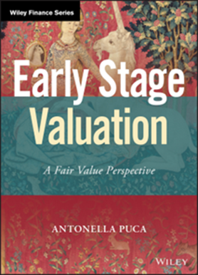
Antonella Puca, CPA/ABV, CFA
Antonella Puca is a Partner with BlueVal in New York. Antonella specializes in the valuation of interests in private equity and venture-backed companies for financial and tax reporting, M&A transactions, buy-sell agreements, gift/estate planning and litigation purposes. Prior to joining BlueVal, Antonella has held positions at various valuation advisory firms, KPMG, EY and RSM US in San Francisco and in New York.
With more than 20 years of experience in the alternative investment industry, Antonella has a particular expertise in providing valuations of GP carried interest, high-growth companies and related complex securities at fair value to private equity and venture capital funds. She has been supporting management in a number of “going public” transactions. She is the author of Early Stage Valuation (Wiley: 2020) and a frequent speaker on the valuation of VC- and PE-backed companies. Antonella is qualified as an expert witness in the State of California.
Antonella is a member of the AICPA and of CFA Institute. She holds the CFA charter and is licensed as a CPA in California and in New York. Antonella has served on the Business Valuation Committee of the AICPA and as a consultant on the CFA exam development team. She has served as a member of AIMA’s research committee, a director and treasurer of the Board of the CFA Society of New York and as a director and consultant on industry standards, practice analysis and curriculum review at CFA Institute. She received the 2021 Business Valuation Volunteer of the Year Award of the AICPA. Antonella earned a degree in Economics, with honors, from the University Federico II of Naples, Italy and a Master in Law Studies in Taxation from NYU School of Law. She has been a research fellow at the Hebrew University of Jerusalem.

Slide 5
Agenda
Portfolio Valuation and the US Capital Markets
Regulatory Update: SEC Rule on Compliance for Private Fund Advisers and the Impact on Valuation
Key Trends in Portfolio Valuation for Private Funds
Q&A

Slide 6
Portfolio Valuation and the U.S. Capital Markets

Slide 7
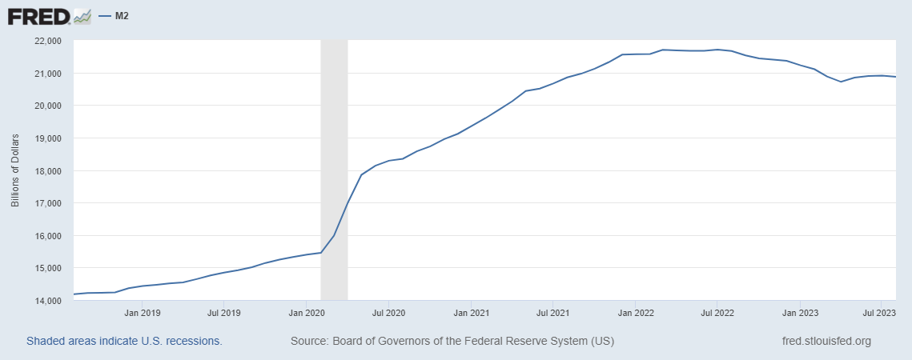
Federal Reserve – M2 Money Supply – 5 Years
M2 = M1+ Savings Deposit + Retail Money Market Funds
Trend: Money Supplies has significantly increased during the Covid Period and has remained close to it peak through today.
Total Assets have not declined, leading market observers to question the future possible efficacy of Fed policy.

Slide 8
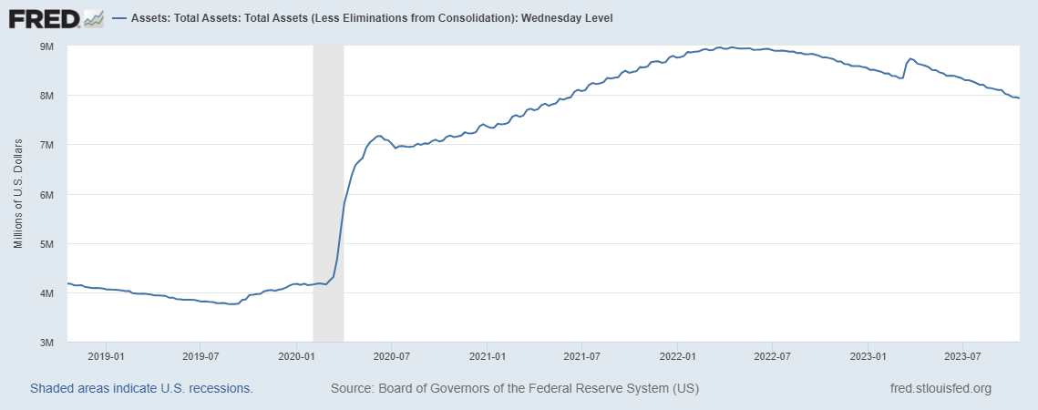
Federal Reserve – Total Assets – 5 Years
Total Assets = $4.2 Trillion as of 1/1/2020
Total Assets = $7.0 Trillion as of 6/24/2020
Total Assets = $7.9 Trillion as of 10/18/2023
Trend: Total Assets have increased by 88%+ from pre-pandemic level.
Fed Assets reached their peak in April 2022 at about $8.9 trillion and are now back to the level of Jul 2021, still significantly higher than pre-pandemic level.

Slide 9
Federal Reserve – Total Assets - Details
The Fed Has substantially expanded its active role as a buyer of Treasury Securities and Mortgage-backed Securities.
The Fed’s open market operations have helped maintain liquidity in the US bond markets.
As of current, Pandemic-related programs are winding down but the Fed’s securities holdings remain close to their record levels.
The Fed’s expanded role in the capital markets is likely to continue in the short/medium term.

Slide 10
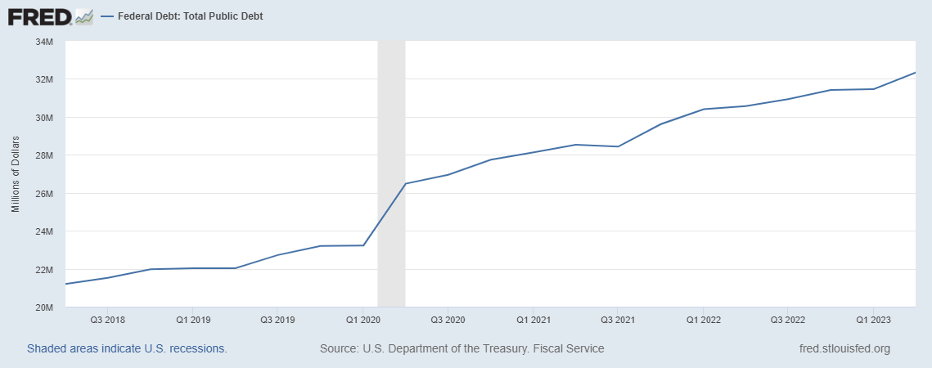
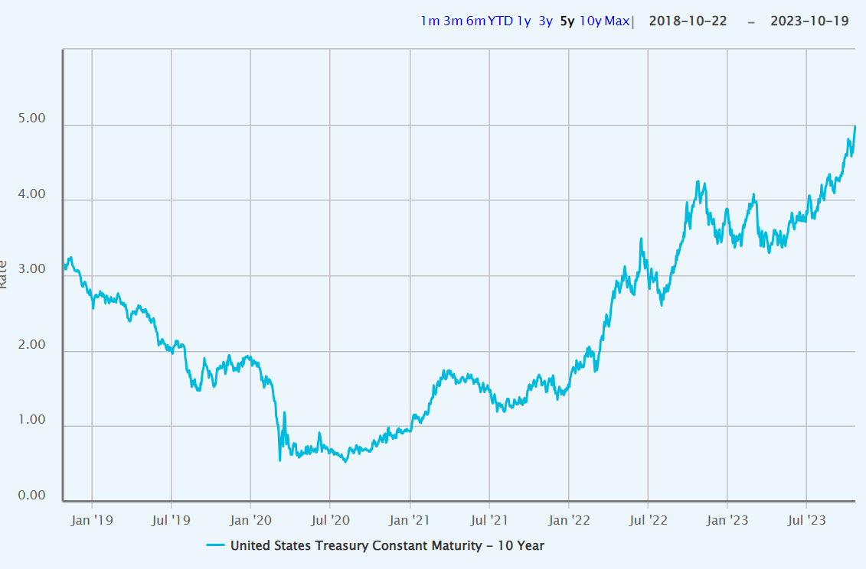
Government Fiscal Policy and Interest Rates
Federal Debt: Total Public Debt – Historical 5 Years
10Y US Treasury Constant Maturity – Historical 5 Years

Slide 11
US Public Equity Markets Performance

Slide 12
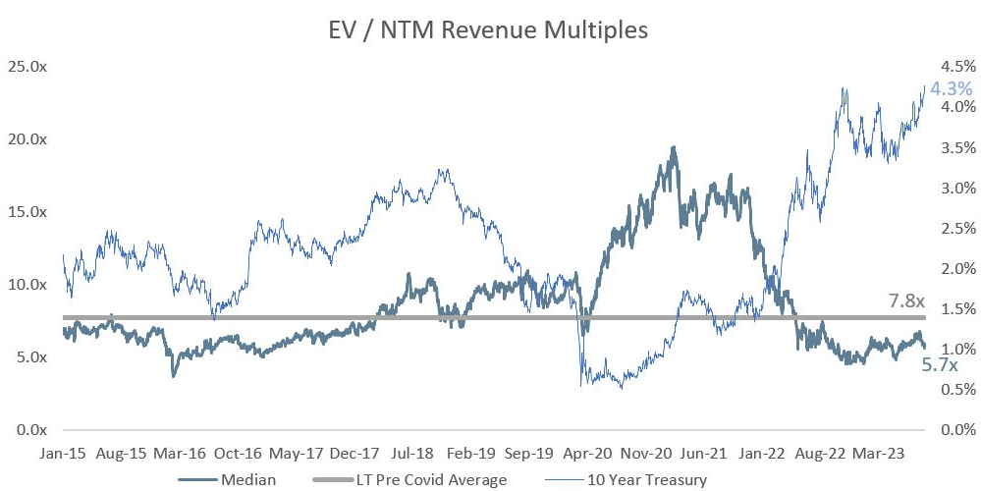
Public “Cloud” Technology Company Valuations

Slide 13
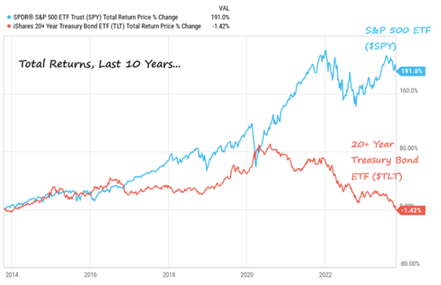
Long Term Bonds

Slide 14
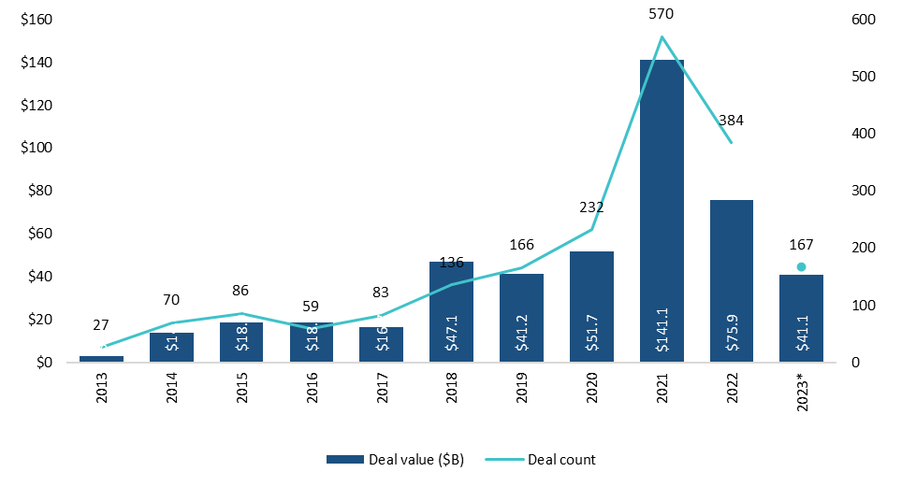

Unicorn Activity: Deal Value and Deal Count
In spite of the pandemic, 1B+ IPOs reached a peak in 2021 and 2022 and are now back to pre-pandemic level.
Cash is drying up.
* As of 9/30/2023. Source: PitchBook Data Inc.
Source: Musée de Cluny, The Lady and Unicorn Tapestry Cycle, Sense of Sight

Slide 15
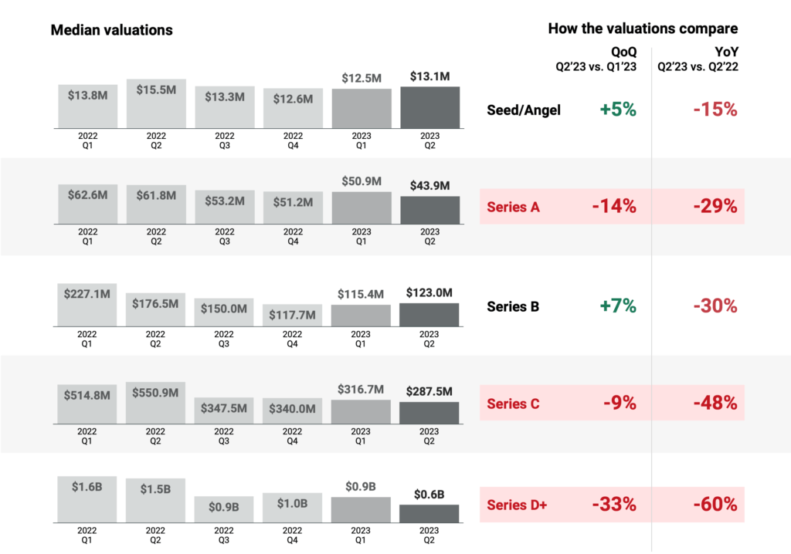
Technology Company Valuations
Source: CB Insights, Tech Valuations Report Q2’23.

Slide 16
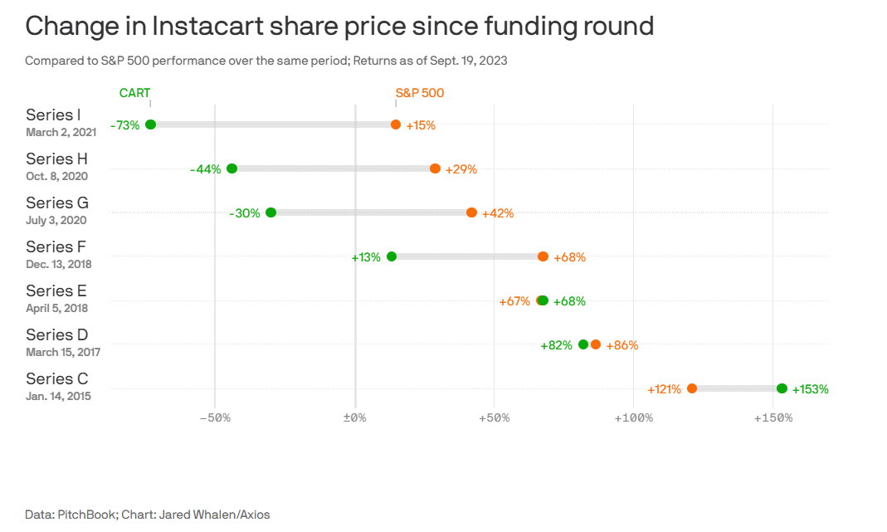
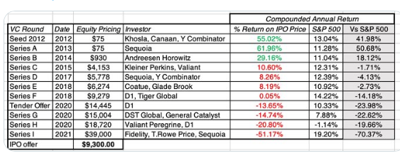
Instacart IPO

Slide 17
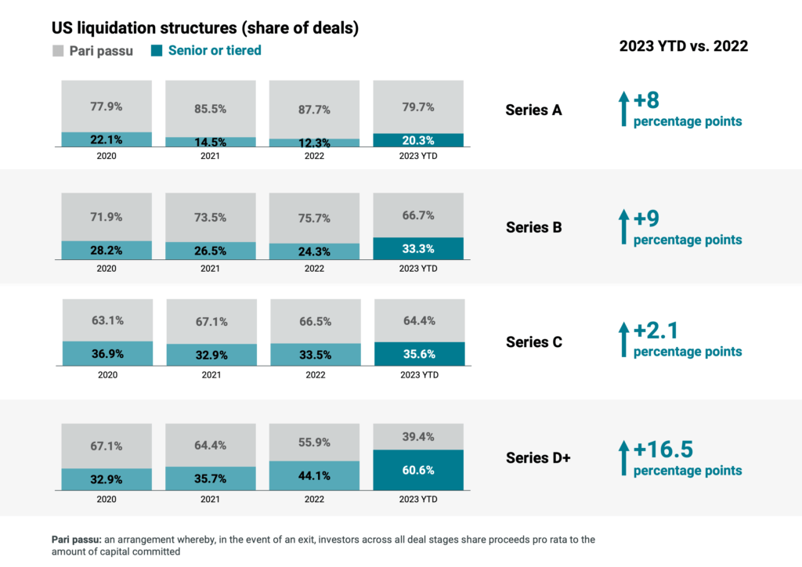
Increased Payout Protection
Source: CB Insights, Tech Valuations Report Q2’23.

Slide 18
SEC New Private Fund Rules: Focus on Valuation

Slide 19
SEC Enhances Regulation of Private Fund Advisers
New Regulation of Private Fund Advisers: On August 23, 2023, The Securities and Exchange Commission (SEC) adopted new rules and rule amendments to enhance the regulation of private fund advisors. The new rules and amendments are designed to increase transparency, competition and efficiency in the private fund markets. The new rules are effective November 13, 2023.
  Restricted Activities: Restricts advisers from engaging in certain activities, including (among others) charging or allocating certain fees and expenses to private funds, unless the adviser meets certain disclosure and, in some cases, consent-based exceptions.
  Preferential Treatment: Prohibits advisers from granting preferential redemption or information rights about portfolio holdings that would have a material, negative effect on other investors in the private fund or a similar pool of assets. Legacy status and limited exemptions are available. For all types of preferential treatment, advisers must: 1) provide advance written notice to prospective investors of preferential treatment related to any material economic terms; and 2) provide timely after-the-fact and annual written notices to current investors of all preferential treatment.
  Enhanced Disclosures: Quarterly information, Annual Audits, Secondary Transactions
  Transition Period: a 12-month transition period for advisers with $1.5 billion or more in private funds assets under management (“larger private fund advisers”) and an 18-month period for advisers with less than $1.5 billion in private funds assets (“smaller private fund advisers”).
  Enhanced role of valuation professionals assisting funds with valuation policies and disclosures.

Slide 20
New Regulation on Private Fund Advisers (continued): Enhanced Disclosures
Annual Audit: Requires SEC-registered advisers to cause (1) each private fund they advise to undergo an annual audit as set forth in the custody rule (Advisers Act rule 206(4)-2), and (2) audited financial statements to be delivered to investors
Quarterly Information: Requires SEC-registered advisers to provide investors with quarterly information about private fund adviser compensation, fund fees and expenses, and performance.
Secondary Transactions: Requires SEC-registered advisers that engage in adviser-led secondary transactions: 1) to obtain and distribute a fairness or valuation opinion; and 2) to provide a summary of any material business relationships between the adviser or its related persons and the independent opinion provider
Compliance Policy Annual Review: Requires SEC-registered advisers to document in writing the annual review they conduct pursuant to the compliance rule (Advisers Act rule 206(4)-7). This applies to all registered advisers, including those that do not advise private funds
Recordkeeping: Requires SEC-registered advisers to retain books and records related to each of the above requirements

Slide 21
New Regulation of Private Fund Advisers (continued):
Annual Audits
Annual Audit: SEC-registered advisers must make sure that:
  Each private fund they advise to undergo an annual audit as set forth in the custody rule (Advisers Act rule 206(4)-2), and
  Audited financial statements are delivered to investors
Effect: extend audit requirements to a broader range of funds. For instance, private advisers have often been able to exclude special purpose vehicles for selected investments and investors from their audit coverage. Those exceptions in many cases will no longer be applicable.
Valuation Professionals: enhance the role of valuation professionals in providing independent portfolio valuation services to SPVs and other private funds that will have to be audited.

Slide 22
New Regulation on Private Fund Advisers (continued): Quarterly Information
Quarterly Information: Requires SEC-registered advisers to provide investors with quarterly information about private fund adviser compensation, fund fees and expenses, and performance.
Effect: make quarterly reporting to investors mandatory for a broad range of funds. Expand the range of information that is disclosed to investors in quarterly statements, to include specific fee disclosures as well as certain performance metrics. Enhance standardization of performance calculation across funds.
Valuation Professionals: enhance the role of valuation professionals in providing independent portfolio valuation services to private funds on quarterly rather than year-end only basis.

Slide 23
New Regulation on Private Fund Advisers (continued):
Secondary Transactions
SEC-registered advisers that engage in adviser-led secondary transactions with respect to any private fund it advisers must:
    obtain and distribute a fairness or valuation opinion prior to the due date of an investor participation election form in respect of the transaction. The opinion must be obtained from an independent opinion provider.
    provide a summary of any material business relationships between the adviser or its related persons and the independent opinion provider within the two-year period immediately prior to the issuance date of the fairness opinion or valuation opinion.
    Independent Opinion Provider: a person that provides fairness opinions or valuation opinions in the ordinary course of its business and is not a related person of the adviser.
    Valuation Profession: expansion of services provided to private funds, possibly by parties other than the valuation firms currently engaged to perform portfolio valuation and/or transaction-related valuations for such funds/advisers. Opportunity for new players to enter the market.

Slide 24
New Regulation on Private Fund Advisers (continued):
Secondary Transactions: Examples
Example of Transactions that may trigger the fairness/valuation opinion requirement:
  Sale of private investments from one fund to another fund managed by the same adviser, so long as the investors must either sell or convert/exchange.
    Funds that are in the liquidation process, with few illiquid investments left: transfer to a continuation vehicle.
    Establishment of a new fund portfolio with a transfer of investments from a pre-existing one
Conditions:
  A fairness opinion or valuation opinion be obtained even should the adviser undertake a competitive bidding process for the assets or if a recent arm’s length transaction has occurred,
  if an investor is allowed to retain its interest in the same fund with respect to the asset subject to the transaction under the same terms, the transaction is likely to be exempt from the fairness/valuation opinion requirement.

Slide 25
New Regulation on Private Fund Advisers (continued):
Secondary Transactions: Fairness or Valuation Opinion?
Fairness Opinion:
  Scope: opinion on whether the transaction is “fair”. In-depth assessment of the conclusions from the various valuation approaches used within the context of facts and circumstances of the transaction.
  Common in investment banking to evaluate the price of a merger, acquisition or takeover.
  Greater flexibility of approach
  Could be used as evidence in lawsuits
  Cost: typically higher than that of a valuation opinion. Cost may be prohibitive for smaller transactions and small/medium-size funds.
Valuation Opinion:
  Scope: opinion on the fair value / fair market value of the investment/s that constitute the transaction.
  Common in financial and tax reporting for U.S. GAAP/IRS compliance.
  Professional standards, U.S. GAAP guidance, other guidance depending on standard of value.
  Needs professional that is familiar with the specific standard and related guidance used.
  Cost: typically lower than that of a fairness opinion.

Slide 26
New Regulation on Private Fund Advisers (continued):
Recordkeeping
Recordkeeping: Requires SEC-registered advisers to retain books and records related to each of the above requirements
Advisers must make and retain copies of:
  the fairness opinion or valuation opinion and material business relationship summary distributed to investors as well as a record of each addressee and the dates in which the opinion and summary were sent.
  the portfolio valuation reports received from independent providers in support of their quarterly investor statements.
  the documentation provided to the independent valuation services firm to support their valuation reports (formation documents, financial statements, projections, capital structure, schedule of debt and cash, and other as applicable).

Slide 27
New Regulation on Private Fund Advisers (continued): Compliance Policy Annual Review
Compliance Policy Annual Review: Requires SEC-registered advisers to document in writing the annual review they conduct pursuant to the compliance rule (Advisers Act rule 206(4)-7). This applies to all registered advisers, including those that do not advise private funds.
Valuation Profession:
  enhanced support for clients in establishing valuation policies and procedures.
  opportunities for new providers separate from those performing independent portfolio valuation services.
  providers may include fund administrators and compliance firms with applicable expertise.

Slide 28
Portfolio Valuation for Private Funds: Key Trends

Slide 29
Complex Capital Structures
Milestone based funding creates complex capital structures that should be addressed from a financial reporting standpoint. The shares are not identical.
  May or may not impact valuation conclusions depending on the capital structure and other considerations
  Most common approaches include current value method, fully diluted allocation, option pricing method
  Common considerations in support of current value method or fully diluted

Slide 30
Greater Focus on Anti-Dilution Rights
Anti-Dilution Rights: contractual provisions that adjust the number of shares / conversion prices to protect the ownership percentage of pre-existing investors in a new round of financing.
Full Ratchet v. Partial Ratchet
Down round of financing

Slide 31
Antidilution Provisions (continued)
Valuation Effects
Series B issuance is a down round
Series A-1 and A-2 antidilution adjustment:
ownership % increases
liquidation preference stays the same

Slide 32
Anti-Dilution Provisions (continued)
Valuation Effects
Breakpoint 1 is the same: liquidation preference is unchanged.
Breakpoints 3 and 4: conversion points have been adjusted down: greater allocation starting from $89.2 million in equity value
Breakpoint 4: all shares are converted into common. Greatest benefit for AD adjusted shares is achieved above this point.

Slide 33
Secondary Market Transactions
One should typically consider any observable transactions in the subject company’s stock. Information to considered regarding secondary market transactions include:
  Timing
  Parties involved
  Volume
  Bid/Ask indications

Slide 34
Valuations Based on Prior Round/Transaction
Considerations for relying on prior round/transaction valuations that occurred more than three months prior to the valuation date:
  Capital structure
  Pre-revenue / information rights
  Calibration
    Multiple compression
    Equity value calibrations

Slide 35
SAFEs beyond Start-ups
SAFE: Simple Agreement for Future Equity. Investment contract that gives the investor the right to participate in the next round of equity financing of a company, typically at a discount from the issue price and subject to a valuation cap.
The valuation cap is typically expressed in terms of a “post-money” or “pre-money” valuation amount. Typically, similar to preferred equity in terms of cash-out rights.
Advantage: allows an investor to participate in a future equity round without the need to fix the issue price of the round immediately.
Risk: may remain outstanding for a while, until the next round take place. May also never convert if the company liquidates without a new round.

Slide 36
Use of SAFEs (continued)
From SAFE Valuation Cap to Implied Equity Value
Inputs: $500 million Post-Money Valuation, 60% Discount, Safe Round of $12 million, 225.0 million of Pre-Round Shares
Problem: Find Conversion Price that would result in a $500 million Post-Money Valuation.

Slide 37
Q&A
Sumeet Bhatnagar, ABV
Managing Director, KPMG
+1-212-954-2666
sumeetbhatnagar@kpmg.com
Antonella Puca, CPA/ABV, CFA
Partner, BlueVal
apuca@blueval-global.com
+1-212-920-4398

